Slide 1
1 Peter 1:8-25
(English Standard Version)

Slide 2
⁸ Though you have not seen him, you love him. Though you do not now see him, you believe in him and rejoice with joy that is inexpressible and filled with glory, ⁹ obtaining the outcome of your faith, the salvation of your souls.
¹⁰ Concerning this salvation, the prophets who prophesied about the grace that was to be yours searched and inquired carefully, ¹¹ inquiring what person or time the Spirit of Christ in them was indicating when he predicted the sufferings of Christ and the subsequent glories. ¹² It was revealed to them that they were serving not themselves but you, in the things that have now been announced to you through those who preached the good news to you by the Holy Spirit sent from heaven, things into which angels long to look.

Slide 3
¹³ Therefore, preparing your minds for action, and being sober-minded, set your hope fully on the grace that will be brought to you at the revelation of Jesus Christ. ¹⁴ As obedient children, do not be conformed to the passions of your former ignorance, ¹⁵ but as he who called you is holy, you also be holy in all your conduct, ¹⁶ since it is written, “You shall be holy, for I am holy.” ¹⁷ And if you call on him as Father who judges impartially according to each one’s deeds, conduct yourselves with fear throughout the time of your exile, ¹⁸ knowing that you were ransomed from the futile ways inherited from your forefathers, not with perishable things such as silver or gold, ¹⁹ but with the precious blood of Christ, like that of a lamb without blemish or spot.

Slide 4
²⁰ He was foreknown before the foundation of the world but was made manifest in the last times for the sake of you ²¹ who through him are believers in God, who raised him from the dead and gave him glory, so that your faith and hope are in God.
²² Having purified your souls by your obedience to the truth for a sincere brotherly love, love one another earnestly from a pure heart, ²³ since you have been born again, not of perishable seed but of imperishable, through the living and abiding word of God;

Slide 5
²⁴ for
“All flesh is like grass
and all its glory like the flower of grass.
The grass withers,
and the flower falls,
²⁵ but the word of the Lord remains forever.”
And this word is the good news that was preached to you.

Slide 6
With Privilege
Comes Responsibility

Slide 7
What a privileged time in which to live....
For thousands of years, the prophets and the angels looked forward to the day when Jesus Christ would carry out God’s plan of salvation
Different prophets had different pieces of the jigsaw puzzle, revealing the sufferings of Christ and the subsequent glories of Christ (resurrection and the return of Christ)
The salvation of our souls will come on the last day when Jesus returns
Jesus Christ reveals Himself, through His servants
The Holy Spirit = The Spirit of Christ
The Spirit of Christ revealed Christ (sufferings, glories) to the Prophets
Holy Spirit announces (through Preachers) – the salvation of our souls (through Jesus)
The primary role of the church, is to preach the Gospel
the Spirit of Christ in them was indicating when he predicted the sufferings of Christ and the subsequent glories.
The glories of Christ (His resurrection & His second coming) followed His suffering
Not just a matter of timing. One depended upon the other.
Same for Christians – Glory follows suffering – We look forward to Glory when Christ returns, even though suffering is a normal part of Christian life

Slide 8
With Privilege Comes Responsibility
ἀναστροφῇ (anastrophē) – Conduct / Way of Life...
As disciples of Jesus Christ, How we live, matters.
No one can be saved by doing good works.
But we who are saved, will do good works.
¹³ Therefore, preparing your minds for action (girding up the loins of your mind), and being sober-minded, set your hope fully on the grace that will be brought to you at the revelation of Jesus Christ.

Slide 9
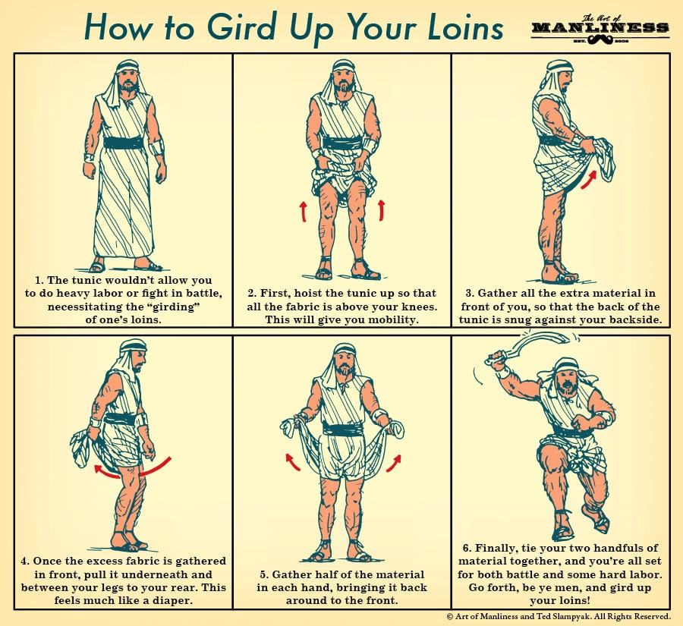

Slide 10
With Privilege Comes Responsibility
ἀναστροφῇ (anastrophē) – Conduct / Way of Life...
As disciples of Jesus Christ, How we live, matters.
No one can be saved by doing good works.
But we who are saved, will do good works.
¹³ Therefore, preparing your minds for action (girding up the loins of your mind), and being sober-minded, set your hope fully on the grace that will be brought to you at the revelation of Jesus Christ.
With minds prepared for work/action and be sober/clear-minded (having good judgment), set our hope fully on our salvation in Christ when He returns.
¹⁴ As obedient children, do not be conformed to the passions of your former ignorance, ¹⁵ but as he who called you is holy, you also be holy in all your conduct, ¹⁶ since it is written, “You shall be holy, for I am holy.”
As disciples of Jesus, we live in today, but not for today. We live for His return
the desires of our former ignorance try to distract us from our new calling in Christ
As children of God, we should respect/honour/obey our Heavenly Father

Slide 11
With Privilege Comes Responsibility
As disciples of Jesus Christ, our Conduct / Way of Life – How we live, matters.
No one can be saved by doing good works.
But we who are saved, will do good works.
With minds prepared for work/action and be sober/clear-minded (having good judgment), set our hope fully on our salvation in Christ when He returns.
¹⁴ As obedient children, do not be conformed to the passions of your former ignorance, ¹⁵ but as he who called you is holy, you also be holy in all your conduct, ¹⁶ since it is written, “You shall be holy, for I am holy.”
As disciples of Jesus, we live in today, but not for today. We live for His return
the desires of our former ignorance try to distract us from our new calling in Christ
As children of God, we should respect/honour/obey our Heavenly Father

Slide 12
Isaiah 6: (ESV) In the year that King Uzziah died I saw the Lord sitting upon a throne, high and lifted up; and the train of his robe filled the temple. ² Above him stood the seraphim. Each had six wings: with two he covered his face, and with two he covered his feet, and with two he flew. ³ And one called to another and said:
“Holy, holy, holy is YHWH of hosts;
the whole earth is full of his glory!”
⁴ And the foundations of the thresholds shook at the voice of him who called, and the house was filled with smoke. ⁵ And I said: “Woe is me! For I am lost; for I am a man of unclean lips, and I dwell in the midst of a people of unclean lips; for my eyes have seen the King, YHWH of hosts!”
⁶ Then one of the seraphim flew to me, having in his hand a burning coal that he had taken with tongs from the altar. ⁷ And he touched my mouth and said: “Behold, this has touched your lips; your guilt is taken away, and your sin atoned for.”

Slide 13
With Privilege Comes Responsibility
As disciples of Jesus Christ, our Conduct / Way of Life – How we live, matters.
No one can be saved by doing good works.
But we who are saved, will do good works.
With minds prepared for work/action and be sober/clear-minded (having good judgment), set our hope fully on our salvation in Christ when He returns.
¹⁴ As obedient children, do not be conformed to the passions of your former ignorance, ¹⁵ but as he who called you is holy, you also be holy in all your conduct, ¹⁶ since it is written, “You shall be holy, for I am holy.”
As disciples of Jesus, we live in today, but not for today. We live for His return
the desires of our former ignorance try to distract us from our new calling in Christ
As children of God, we should respect/honour/obey our Heavenly Father
Obedience... Holiness –– In all our conduct
Even the words of our mouth betray the unholy state of our hearts
Because our Heavenly Father is Holy, so should His children be holy
The fact that God is a righteous Judge, should fill us with fear
The cost of our forgiveness and holiness is enormous – the blood of Jesus

